Slide 1
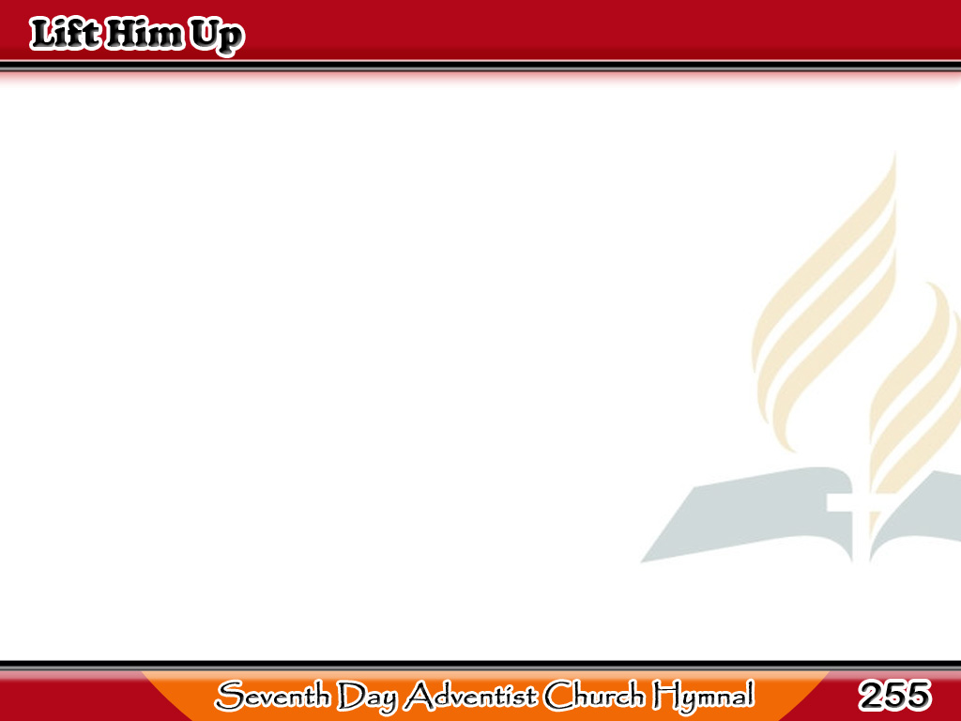
Itaas Siya
Lift Him up, ‘tis He that bids you,
Let the dying look and live;
To all weary, thirsting sinners,
Living waters will he give;
1/4

Slide 2
Itaas Siya
And though once
so meek and lowly,
Yet the Prince
of heaven was He;
1/4

Slide 3
Itaas Siya
And the blind,
who grope in darkness,
Through the blood
of Christ shall see.
1/4

Slide 4
Itaas Siya
-Refrain-
Lift Him up, the risen Savior,
High amid the waiting throng;
Lift Him up, ‘tis He that speaketh,
Now He bids you flee from wrong.
1/4

Slide 5
Itaas Siya
Lift Him up,
this precious Savior,
Let the multitude behold;
2/4

Slide 6
Itaas Siya
They with willing hearts
shall seek Him,
He will draw them to His fold;
2/4

Slide 7
Itaas Siya
They shall gather
from the wayside,
Hastening on with joyous feet,
2/4

Slide 8
Itaas Siya
They shall bear
the cross of Jesus,
And shall find salvation sweet.
2/4

Slide 9
Itaas Siya
-Refrain-
Lift Him up, the risen Savior,
High amid the waiting throng;
Lift Him up, ‘tis He that speaketh,
Now He bids you flee from wrong.
2/4

Slide 10
Itaas Siya
Lift Him up in all His glory,
‘Tis the Son of God on high;
Lift Him up,
his love shall draw them,
E’en the careless shall draw nigh;
3/4

Slide 11
Itaas Siya
Let them hear again the story
Of the cross,
the death of shame;
3/4

Slide 12
Itaas Siya
And from tongue
to tongue repeat it;
Mighty throngs
shall bless His name.
3/4

Slide 13
Itaas Siya
-Refrain-
Lift Him up, the risen Savior,
High amid the waiting throng;
Lift Him up, ‘tis He that speaketh,
Now He bids you flee from wrong.
3/4

Slide 14
Itaas Siya
O then lift Him up in singing,
Lift the Savior up in prayer;
He, the glorious Redeemer,
All the sins of men did bear;
4/4

Slide 15
Itaas Siya
Yes, the young
shall bow before Him,
And the old their voices raise;
4/4

Slide 16
Itaas Siya
All the deaf
shall hear hosannah;
And the dumb
shall shout His praise.
4/4

Slide 17
Itaas Siya
-Refrain-
Lift Him up, the risen Savior,
High amid the waiting throng;
Lift Him up, ‘tis He that speaketh,
Now He bids you flee from wrong.
4/4

